Slide 1
Azure Data Lake Gen2

Slide 2
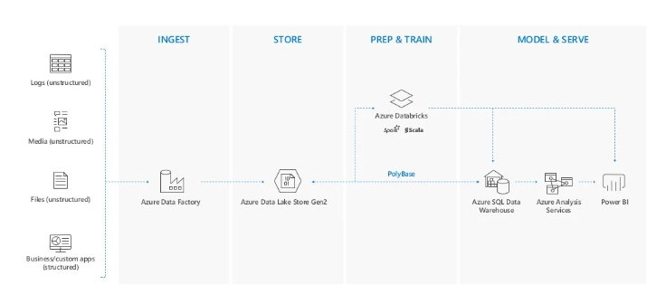
Modern Data Warehouse

Slide 3
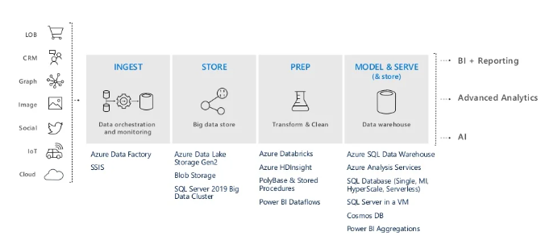

Slide 4
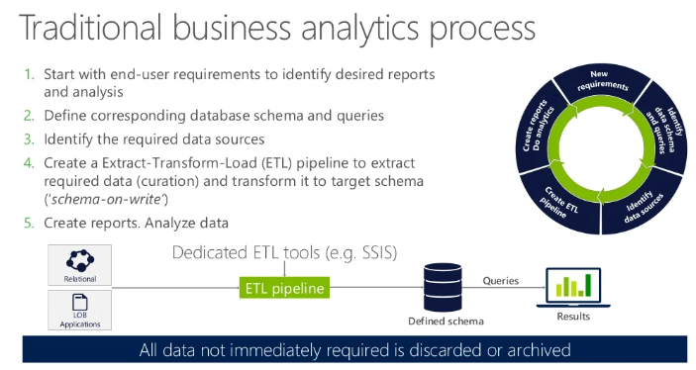
Why Data Lake

Slide 5
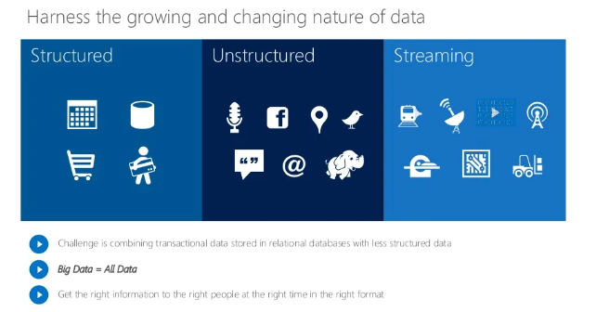

Slide 6
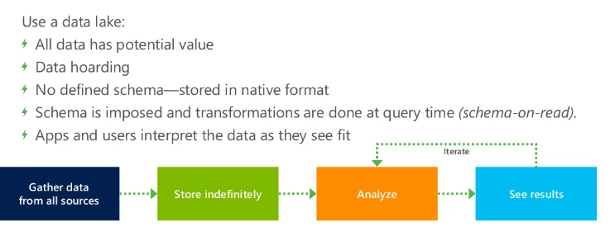
New Big Data Thinking

Slide 7
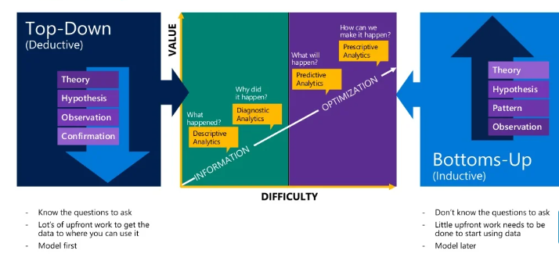

Slide 8
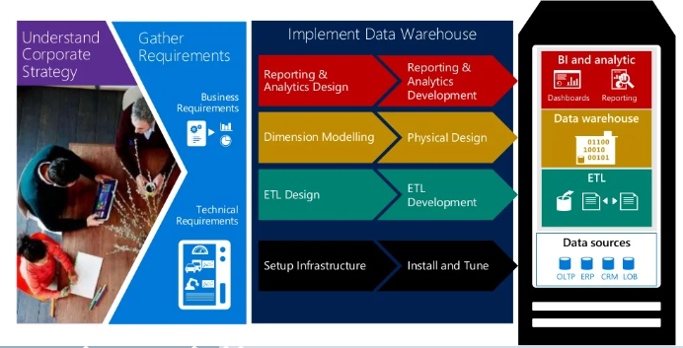
Data Warehouse a Top-Down approach

Slide 9
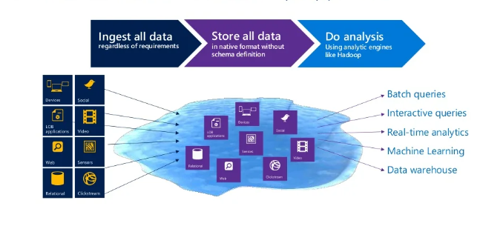
Data Lake – A Bottom-up Approach

Slide 10
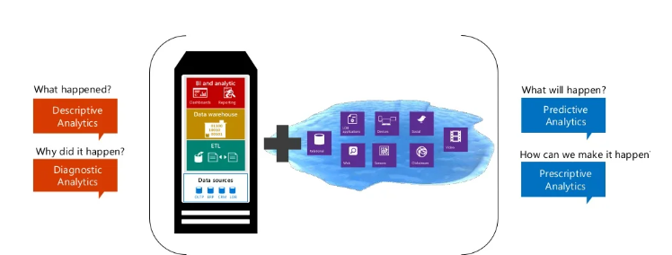
Data Lake and Data Warehouse – better together

Slide 11
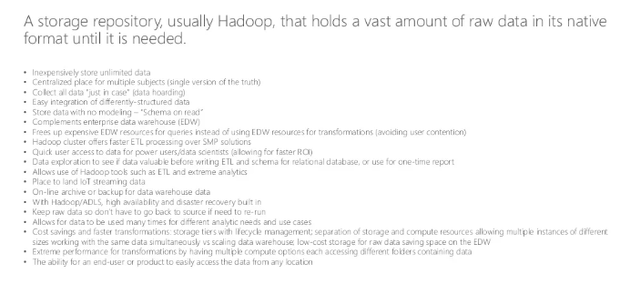
What is Data Lake

Slide 12
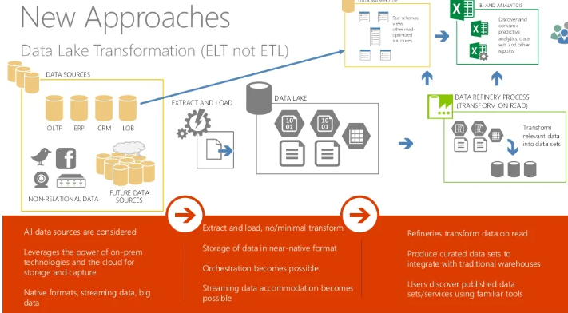

Slide 13
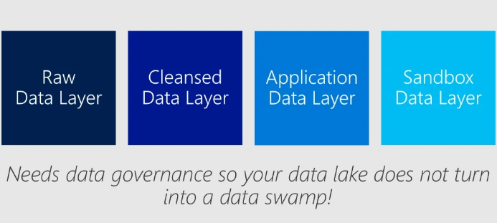
Azure Data Lake Layers

Slide 14
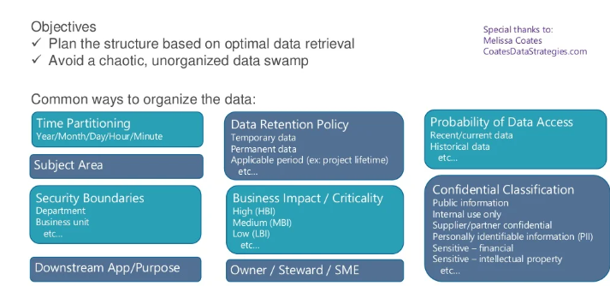
Organizing Data Lake

Slide 15
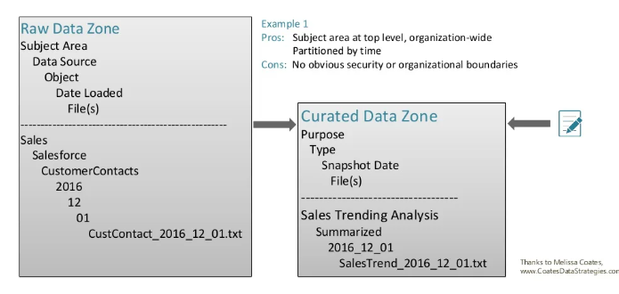
Organizing Data Lake

Slide 16
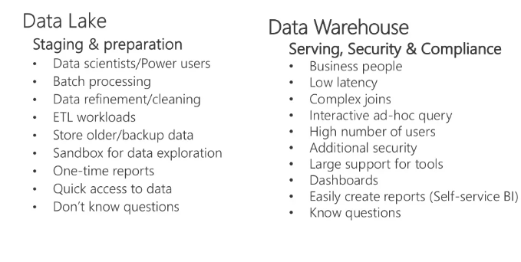
Data Lake Use Cases

Slide 17
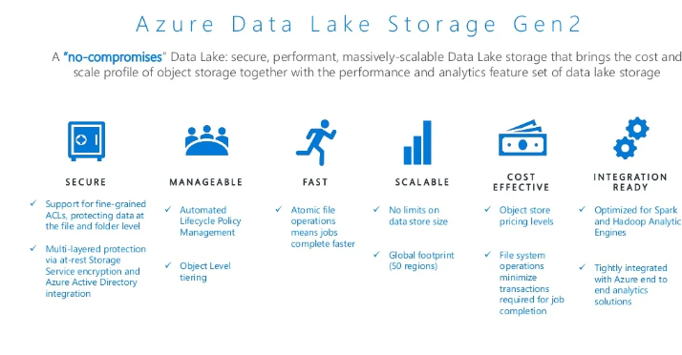
Azure Data Lake Gen2

Slide 18
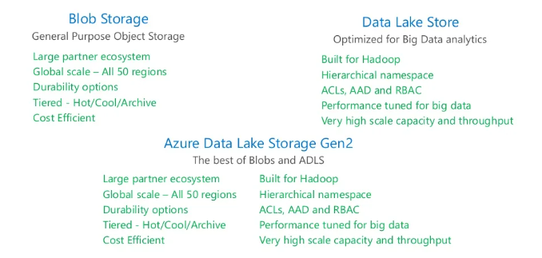
Convergence of Two storage layers

Slide 19
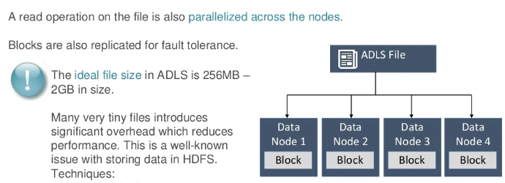
Azure Data Lake Store – Distributed File System

Slide 20
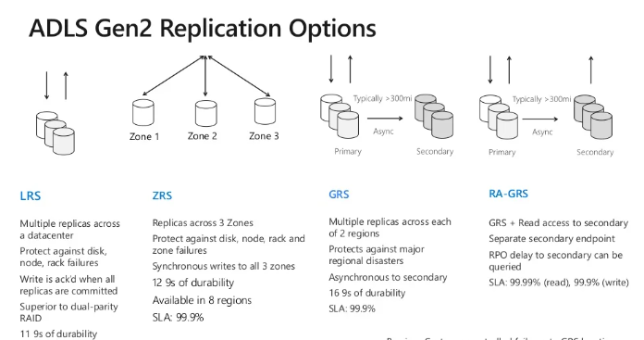
ADLS Gen2 Replication Options

Slide 21
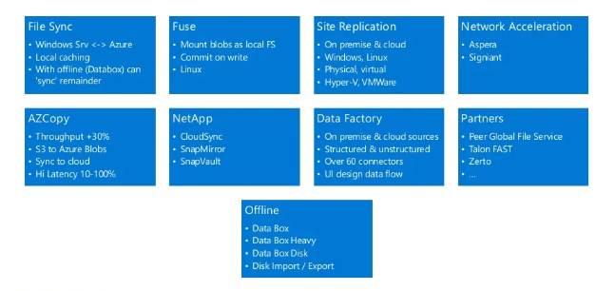
Data Transfer Methods

Slide 22
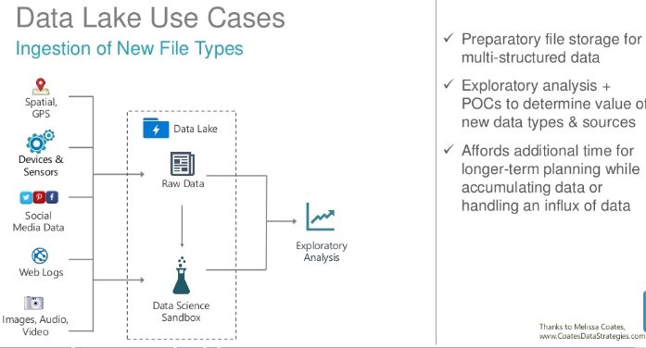
Data Lake Use Cases

Slide 23
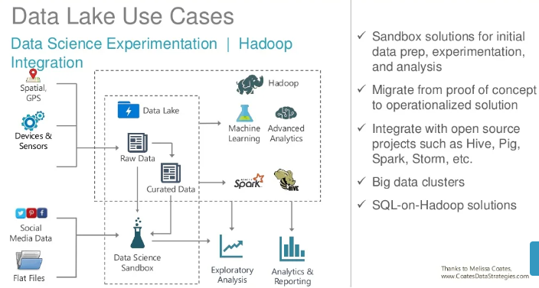

Slide 24
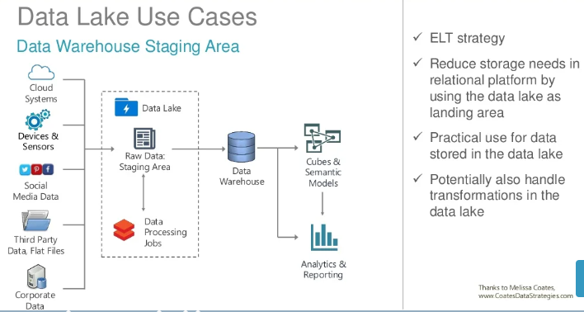
Data Lake Use Cases

Slide 25
